Slide 1
C4771002
A PHASE 3, PLACEBO-CONTROLLED, DOUBLE-BLINDED, RANDOMIZED
STUDY TO EVALUATE THE EFFICACY, SAFETY, AND TOLERABILITY OF A
CLOSTRIDIOIDES DIFFICILE VACCINE IN ADULTS 65 YEARS OF AGE AND OLDER
Pre-Screening Site Training
V1 03Sep25

Slide 2
C .Difficile
Disease Burden
CDI is increasingly recognized and has emerged in populations previously considered to be low risk and lacking the traditional risk factors for CDI.
In 2019, there were approximately 202,600 hospitalized CDI cases in the US and 11,500 were fatal
In 2022, the most recent data collection period from the CDC Emerging Infectious Program surveillance- 48% of all CDI cases reported were in individuals ≥65

Slide 3
Sites conducting Pre-Screening activities:
Family Care Medical Group
Connect Care
Upstate Hospitalists
Upstate Emergency Departments (Downtown & Community)
Infectious Disease Associates
Global Health Institute

Slide 4
Pre-Screening activities include….
Review patient chart for eligibility based on protocol criteria
1
Provide patient with IRB approved study information
2
Provide patient demographics and documentation of eligibility
3

Slide 5
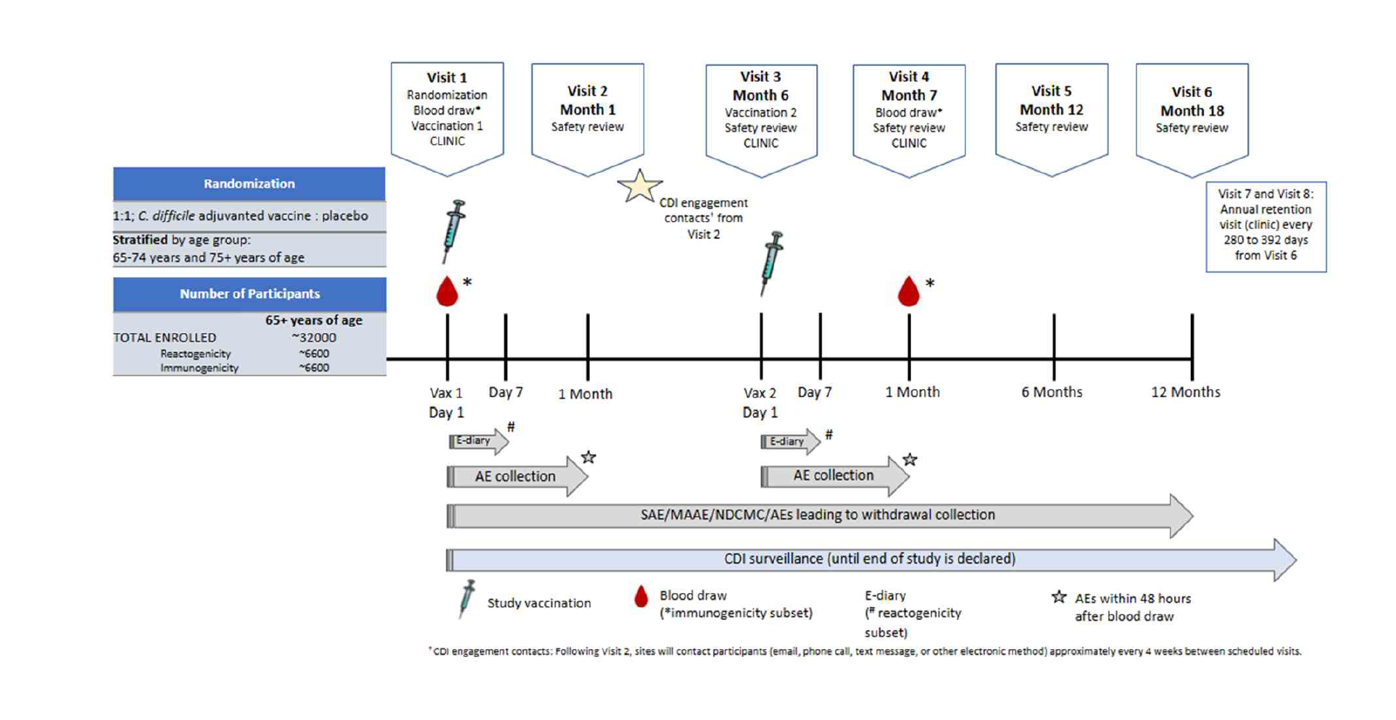

Slide 6
Study Synopsis
32,000 total enrollment, 200 sites, 4 countries
1:1 to C. difficile adjuvanted vaccine or placebo (saline)
32,000 participants ≥65 years of age
Minimum of 4,000 participants enrolled in the ≥75-year age stratum
5 clinic visits: Vaccine 1 (Day 0), Vaccine 2 (Month 6), Follow up (Month 7), Follow up (Month 30), Follow up (Month 42)
3 telephone calls: Month 1, Month 12, Month 18
Contact every 4 wks between visits to remind of stool collection procedures and if kit resupply is needed

Slide 7
Potential CDI
3+ unformed stools in a 24-hour period
collect the 4th or subsequent unformed stool send to central laboratory
contact the study site to assess for a potential CDI case
may be conducted in clinic or via remote methods
EPIC or other EMR may be used to identify potential CDI and prompt an unscheduled disease visit evaluation

Slide 8
Inclusion Criteria
Age 65+
1 of the following criteria:
  1 hospitalization for 2+ nights in the past 12 months
  2 emergency room visits in the past 12 months
  10 out-patient visits in the past 12 months (PCP or secondary care)
  Antibiotics for 48hrs+ in the past 12 weeks
  Planned hospitalization of 2+ nights or elective surgery (any duration) 14+ days after vaccination #2

Slide 9
Exclusion Criteria
Prior episode of confirmed CDI (laboratory, colonoscopy, surgery or pathology)
Prior large or small bowel resection (does not include appendectomy)
Any condition or treatment resulting in frequent diarrhea
Immunodeficiency (determined by history and lab results)
  Chronic stable HIV, HBV or HCV may be considered for inclusion if they have a viral load less then 50 copies and CD4 count less than 200 and on stable antiretroviral meds within 6 months
Metastatic malignancy, Dialysis, or terminal condition within 12 months
Suicidal ideation in the past year or suicidal behavior in the past 5 years

Slide 10
Subject Compensation
$150 each on-site study visit
$50 each telephone visit
$150 each CDI in person or remote visit
$75 for vaccination eDiary completion for a period of 7 days
$10 per month for the Diarrhea e-diary every 2 weeks

Slide 11

Workflow…
Clinician identifies patient eligible for study & gives patient info
FCMG & Emergency Departments
Submit data via RedCap
Connect Care/Hospitalists & IDA
Submit data via EPIC
GHI will contact patient within 1-2 business days to schedule
GHI will track charts reviewed by each group for compensation
Planning for 200-400 charts reviewed per Pre-Screening site
GHI will enroll 1,000 subjects into study

Slide 12
How to contact us with questions….
trials@upstate.edu
24/7 on call phone # 315-459-3031
Main office # 315-464-5960 (Mon-Fri, 8am-4:30pm)

